Slide 1

PT. Sinar Tanjung Priok

Slide 2

Heavy delivery made easy!

Slide 3

OUR HISTORY
Established in 2000, Sinar Tanjung Priok (STP) has two decades of experience and advance towards being the pioneer of Indonesian logistic service and the solution to every logistic business. Anton Syawal, the founder of STP, who was a young, passionate individual, tried his luck with just 5.000 rupiahs in his possession to start a logistics business.
Those 5.000 rupiahs were the key to Syawal’s dream in creating an answer towards logistical problems in the 2000s: limited connectivity, expensive shipping costs, and the lack of technology at the time. His passion and integrity brought an strengthening to Indonesia’s logistics industry as STP has helped and built partnership with customers from all around Indonesia.

Slide 4
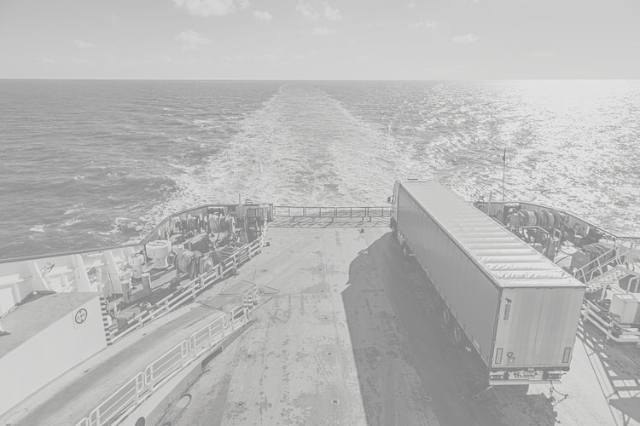
STP was founded with passion and a simple yet noble objective: it is to carefully and safely deliver goods of yours truly to the front of your place at a revolutionary price.
STP is currently pushing beyond the barrier to be the leading delivery service for socially conscious businesses by being a trusted and guaranteed logistics company to its customers and a trucking company with various fleets, trucks and trailers.
STP’s aforementioned vision will be achieved through more accessibility and inclusivity by adding STP trucking area coverage throughout Indonesia to meet diverse logistics needs with a fleet of best quality.

Slide 5
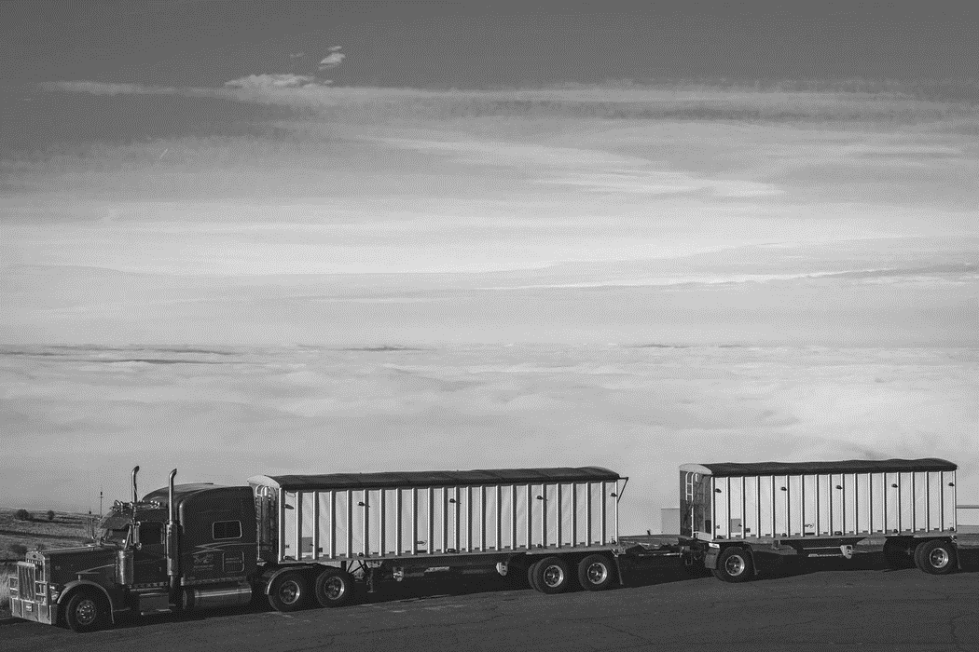
OUR SERVICES
We are a logistic company that specializes in trucking services.
We offer a line of armada that caters to your needs.

Slide 6
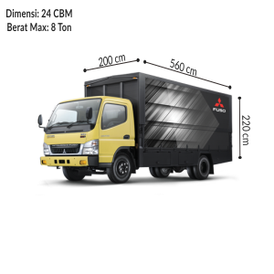
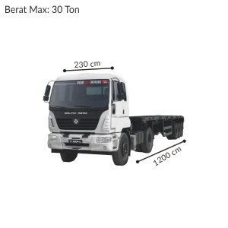
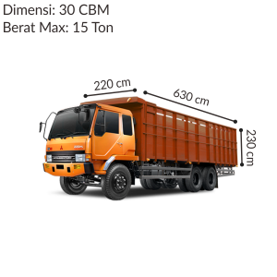
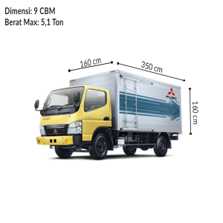
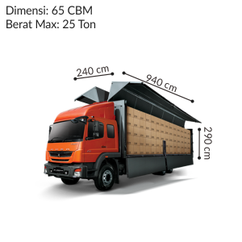
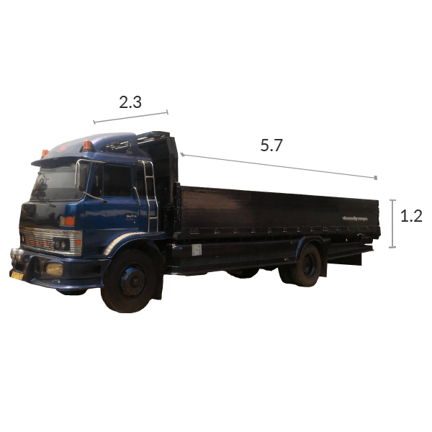
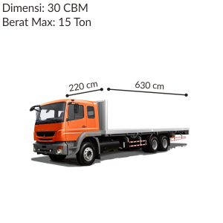
OUR SERVICES
Our fleet of trucks include various Colt Diesel trucks and various kinds of Loader trucks. The kinds of trucks that we offer have various specifications to ensure our customers’ needs are fulfilled.

Slide 7
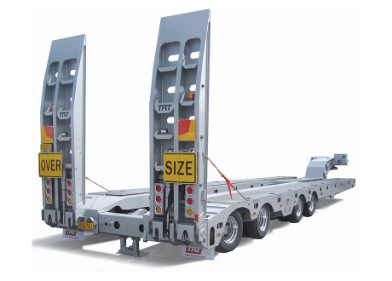
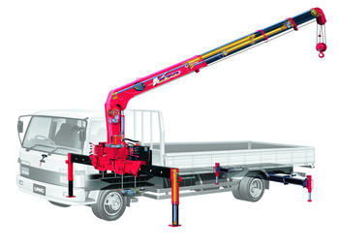
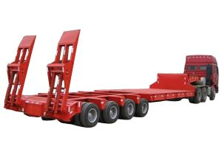
OUR SERVICES
We also offer other items for our customers to rent. These items include trailers, safe loaders, and cranes, etc.

Slide 8
OUR STRENGTHS
We aim at delivering high-quality servicey that satisfies the needs of our cherished customers.
DEDICATED
FLEET AND EQUIPMENT
TAILORED SERVICES
We provide highly customized services that caters to your needs to expand opportunities and address specific challenges.
Large or small, fleets matter. We offer dedicated fleet and equipment, licensed for exclusive use by one or more shippers for on-time delivery performance, guaranteed capacity, and reduced freight transportation costs.
SPECIALIZE STANDARD OPERATIONAL PROCEDURE
INSURANCE COVERAGE
Our specialized SOP are created to ensure compliance standards are met, yet are designed uniquely according to client needs by defining the goals that the process will accomplish and breaking these into individual steps to achieve that goal.
We provide xxxx types of insurance plans to back up clients from unexpected events and unforeseen occurance.

Slide 9




OUR PARTNERS
Through our 20 years of experience in the industry, we have built long-lasting partnerships with various businesses. Our partnerships go beyond simple business matter. The bonds that we built with our partners are based on our integrity and trusted, high quality services. We are a customer-centric company; we focus on the needs of our partners and deliver tailored services to satisfy their needs.

Slide 10

SERVICE AREA COVERGE
We have eight fleets stationed in Jawa, Bali, and Lampung.
Twelve more fleets are available on the go.

Slide 11
CONTACT US!
ADDRESS
JL. Ganggeng III No. 32, Jakarta Utara, DKI Jakarta
PHONE
0853 xxxxx
EMAIL
xxx@stp.com

